Slide 1
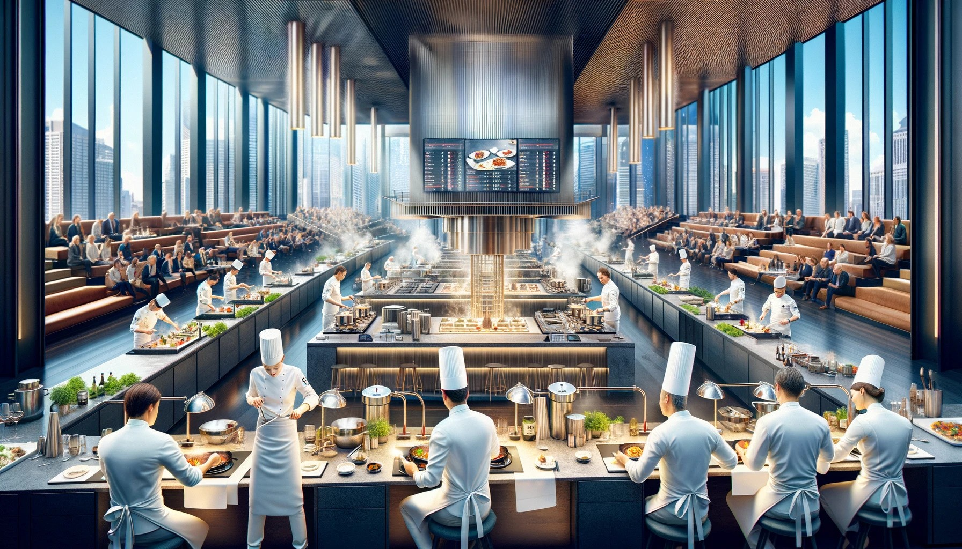

Restaurant Management System
Team Members 1. Sharmin Sultana Shila (23101070). 2. Uday Majumder (23101082). 3. Md. Junaid Al Mahir (23101058).
In today's fast-paced food and hospitality industry, efficient data management plays a crucial role in ensuring customer satisfaction and streamlined operations. This project presents the design and implementation of a Restaurant Management System using a MySQL relational database. The system incorporates essential functionalities such as customer and waiter management, food item cataloging, order processing, billing, and table reservations.
With carefully designed tables and relationships—such as Customer, Food, Customer_Order, Reserve_Table, and Payment—this system models real-world restaurant operations. Advanced SQL queries have been used to extract meaningful insights such as top-selling items, customer spending behavior, and available tables, which help in decision-making and business optimization
Objective

Slide 2
Team Members 1. Sharmin Sultana Shila (23101070). 2. Uday Majumder (23101082). 3. Md. Junaid Al Mahir (23101058).
In today's fast-paced food and hospitality industry, efficient data management plays a crucial role in ensuring customer satisfaction and streamlined operations. This project presents the design and implementation of a Restaurant Management System using a MySQL relational database. The system incorporates essential functionalities such as customer and waiter management, food item cataloging, order processing, billing, and table reservations.
With carefully designed tables and relationships—such as Customer, Food, Customer_Order, Reserve_Table, and Payment—this system models real-world restaurant operations. Advanced SQL queries have been used to extract meaningful insights such as top-selling items, customer spending behavior, and available tables, which help in decision-making and business optimization
Objective

Slide 3








Restaurant Management System
In today's fast-paced food and hospitality industry, efficient data management plays a crucial role in ensuring customer satisfaction and streamlined operations. This project presents the design and implementation of a Restaurant Management System using a MySQL relational database. The system incorporates essential functionalities such as customer and waiter management, food item cataloging, order processing, billing, and table reservations.
With carefully designed tables and relationships—such as Customer, Food, Customer_Order, Reserve_Table, and Payment—this system models real-world restaurant operations. Advanced SQL queries have been used to extract meaningful insights such as top-selling items, customer spending behavior, and available tables, which help in decision-making and business optimization
Objective
Functionalities
Customer Handling
Store and manage customer details.
Billing
Calculate and manage payment details.
Table Reservation
Reserve and track table availability.
Waiter Info
Store waiter data and table assignments.
Reporting
Show top-selling items, customer spend, and city stats.
Menu Management
Maintain food items, categories, and prices.
Order System
Record food orders by customers.
Database Operations
Support updates, renaming, and modifications.

Slide 4
Restaurant Management System
In today's fast-paced food and hospitality industry, efficient data management plays a crucial role in ensuring customer satisfaction and streamlined operations. This project presents the design and implementation of a Restaurant Management System using a MySQL relational database. The system incorporates essential functionalities such as customer and waiter management, food item cataloging, order processing, billing, and table reservations.
With carefully designed tables and relationships—such as Customer, Food, Customer_Order, Reserve_Table, and Payment—this system models real-world restaurant operations. Advanced SQL queries have been used to extract meaningful insights such as top-selling items, customer spending behavior, and available tables, which help in decision-making and business optimization
Objective
Functionalities
Customer Handling
Store and manage customer details.
Billing
Calculate and manage payment details.
Table Reservation
Reserve and track table availability.
Waiter Info
Store waiter data and table assignments.
Reporting
Show top-selling items, customer spend, and city stats.
Menu Management
Maintain food items, categories, and prices.
Order System
Record food orders by customers.
Database Operations
Support updates, renaming, and modifications.

Slide 5
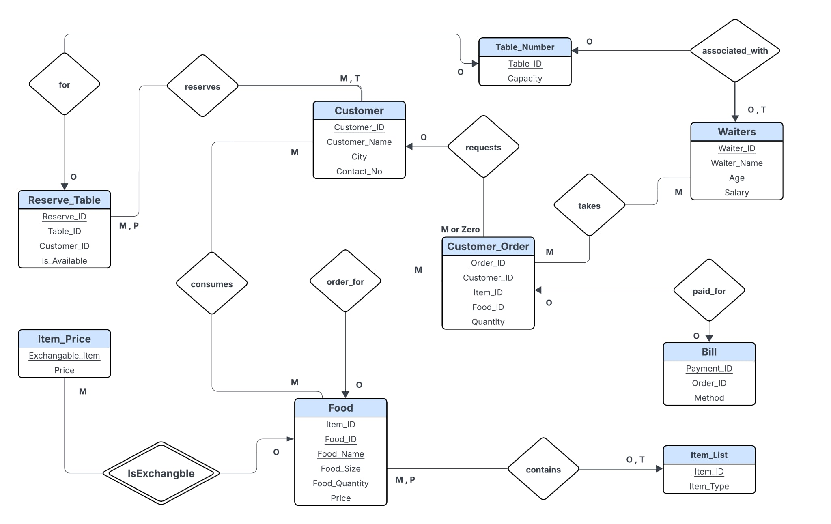
ER Diagram

Slide 6
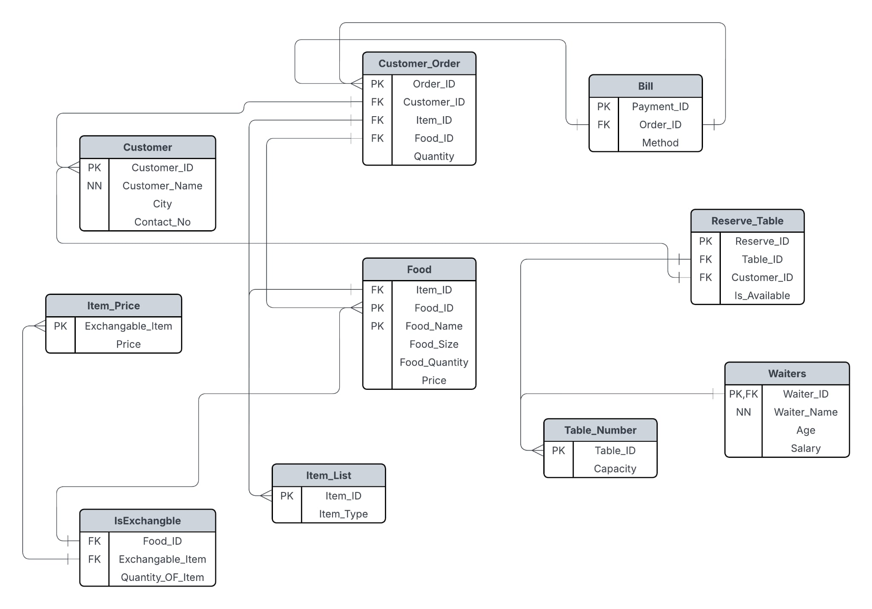
Schema Diagram

Slide 7
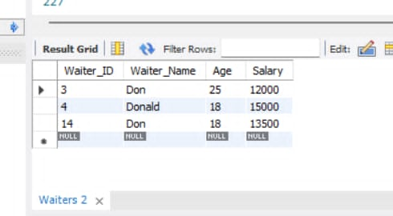
Sample Queries
-- 1. Find the waiters details whose name starts with 'Don'.
SELECT * FROM Waiters WHERE Waiter_Name LIKE "Don%";

Slide 8
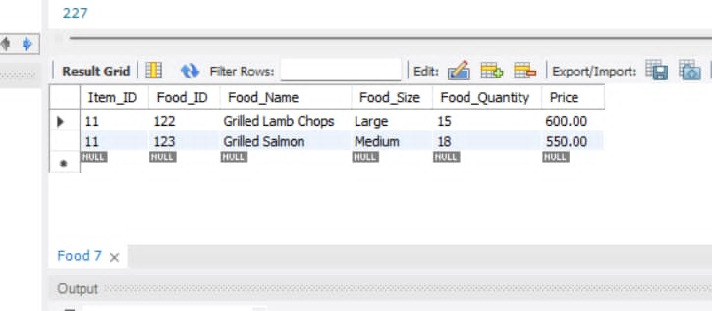
Sample Queries
-- 2. Find the food list of menu 11.
SELECT * FROM Food WHERE Item_ID = 11;

Slide 9
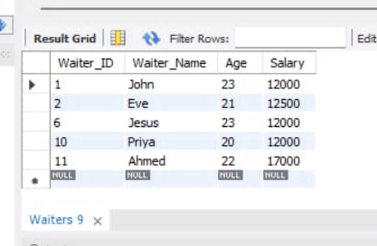
Sample Queries
-- 3. Find the Waiter details whose age is between 20-23.
SELECT * FROM Waiters WHERE Age BETWEEN 20 AND 23 ;

Slide 10
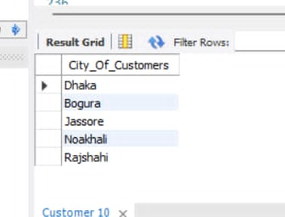
Sample Queries
-- 4. Find the cities that customer belongs from.
SELECT DISTINCT City AS City_Of_Customers FROM Customer LIMIT 5;

Slide 11
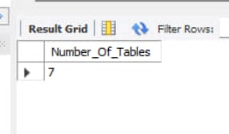
Sample Queries
-- 5. Select the total number of tables in that restaurent .
SELECT COUNT(Table_ID) AS Number_Of_Tables FROM Table_Number where Capacity >= 08;

Slide 12
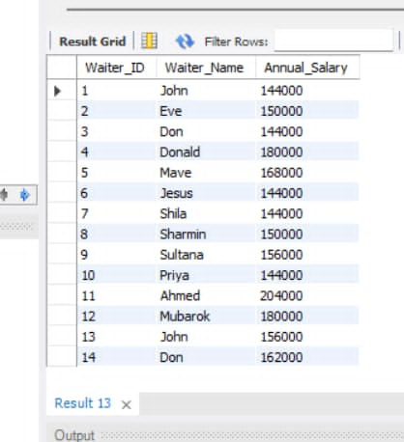
Sample Queries
-- 6. Annual salary of the Waiters.
SELECT Waiter_ID,Waiter_Name,12*Salary AS Annual_Salary FROM Waiters ;

Slide 13
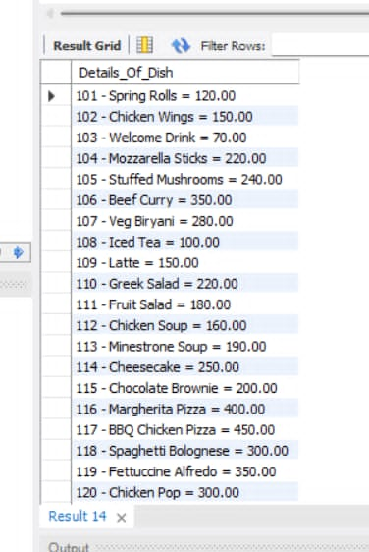
Sample Queries
-- 7. Concatenate the list of food and name corresponding to their price.
SELECT CONCAT(Food_ID, " - ",Food_name, " = ", Price) AS Details_Of_Dish FROM Food;

Slide 14
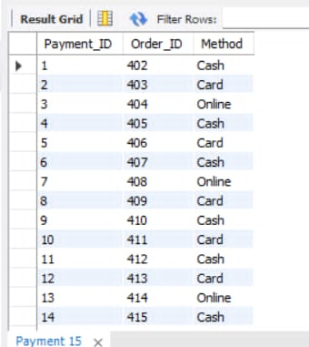
Sample Queries
-- 8. Change the name of "Bill" Table.
ALTER TABLE Bill RENAME TO Payment;
SELECT * FROM Payment;

Slide 15
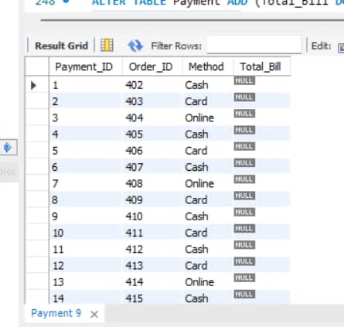
Sample Queries
-- 9.Add a new column in existing table "Payment".
ALTER TABLE Payment ADD (Total_Bill DOUBLE(6,2));
SELECT * FROM Payment;

Slide 16
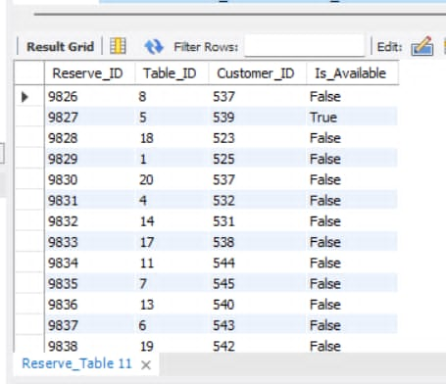
Sample Queries
-- 10. Make a reserved seat availabe for other customers.
UPDATE Reserve_Table SET Is_Available = "True" WHERE table_ID = 05;
SELECT * FROM Reserve_Table;

Slide 17
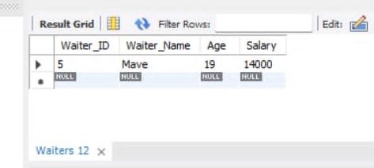
Sample Queries
-- 11. Find the waiter details of table no 05..
SELECT * FROM Waiters WHERE Waiter_ID IN
(SELECT Table_ID FROM Table_Number WHERE Table_ID = 05 );

Slide 18
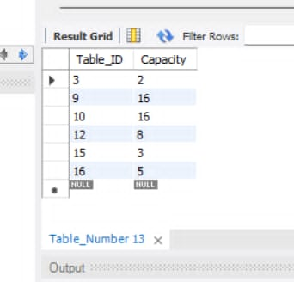
Sample Queries
-- 12. Find availabe seats in that Restaurant.
SELECT Table_ID, Capacity FROM Table_Number WHERE Table_ID Not IN( SELECT Table_ID FROM Reserve_Table );

Slide 19
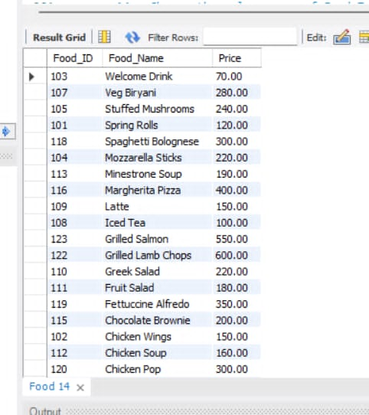
Sample Queries
-- 13. Show the list of food names in descending order.
SELECT Food_ID,Food_Name,Price FROM Food Order By Food_name DESC;

Slide 20
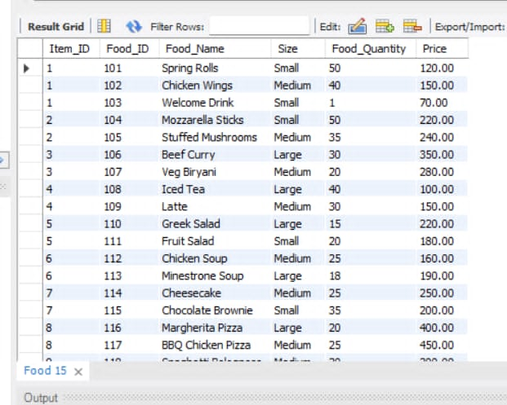
Sample Queries
-- 14. Change the column name of Food Table.
ALTER TABLE Food CHANGE COLUMN Food_Size Size VARCHAR(15) NOT NULL ;
SELECT * FROM Food;

Slide 21
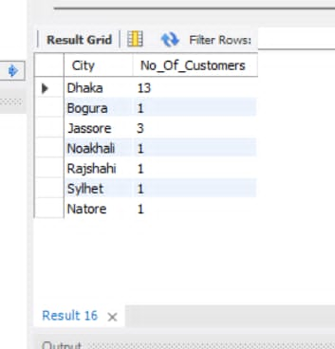
Sample Queries
-- 15. Count the number of customers from each city.
SELECT City, COUNT(Customer_ID) As No_Of_Customers FROM Customer GROUP BY City;

Slide 22
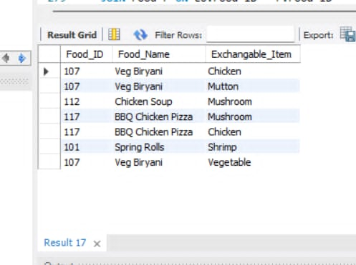
Sample Queries
-- 16. Show the list of foods that are exchangable by other items.
SELECT F.Food_ID,F.Food_Name, E.Exchangable_Item FROM Food as F, IsExchangble as E WHERE F.Food_ID = E.Food_ID ;

Slide 23
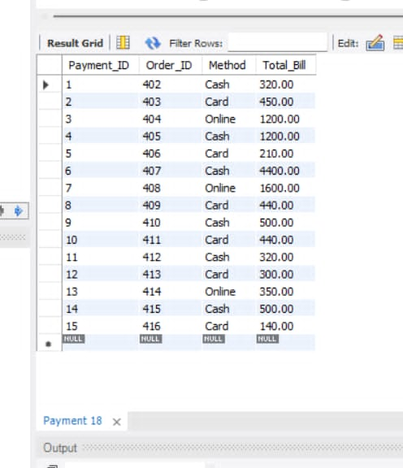
Sample Queries
-- 17. Fill up the Total_Bill column of Payment table according to the customers order.
UPDATE Payment P
JOIN Customer_Order CO ON P.Order_ID = CO.Order_ID
JOIN Food F ON CO.Food_ID = F.Food_ID
SET P.Total_Bill = CO.Quantity * F.Price;
SELECT * FROM Payment;

Slide 24
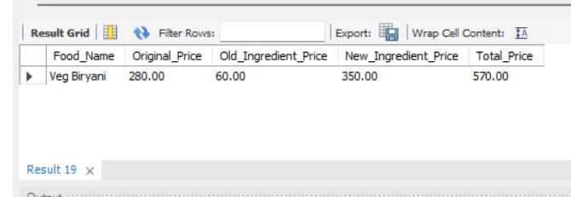
Sample Queries
-- 18. Replace vegetable from "Veg Biryani" by Mutton.
SELECT
F.Food_Name,
F.Price AS Original_Price,
IP1.Price AS Old_Ingredient_Price,
IP2.Price AS New_Ingredient_Price,
(F.Price - IP1.Price + IP2.Price) AS Total_Price
FROM Food AS F
JOIN IsExchangble E1 ON F.Food_ID = E1.Food_ID AND E1.Exchangable_Item = 'Vegetable'
JOIN IsExchangble E2 ON F.Food_ID = E2.Food_ID AND E2.Exchangable_Item = 'Mutton'
JOIN Item_Price IP1 ON E1.Exchangable_Item = IP1.Exchangable_Item
JOIN Item_Price IP2 ON E2.Exchangable_Item = IP2.Exchangable_Item
WHERE F.Food_Name = 'Veg Biryani';

Slide 25
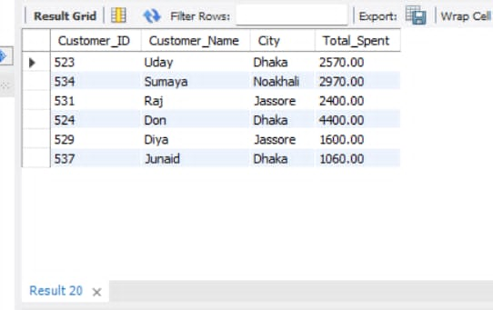
Sample Queries
-- 19. count the number of customers who purchased more than 1000BDT in each city in ascending order.
SELECT C.Customer_ID, C.Customer_Name, C.City, SUM(O.Quantity * F.Price) AS Total_Spent
FROM Customer C
JOIN Customer_Order O ON C.Customer_ID = O.Customer_ID
JOIN Food F ON O.Food_ID = F.Food_ID
GROUP BY C.Customer_ID, C.Customer_Name, C.City HAVING SUM(O.Quantity * F.Price) > 1000;

Slide 26
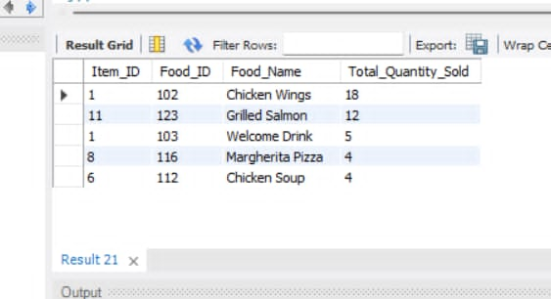
Sample Queries
-- 20. Show the top 5 most famous selling item in this restaurant.
SELECT F.Item_ID, F.Food_ID, F.Food_Name, SUM(O.Quantity) AS Total_Quantity_Sold
FROM Food F
JOIN Customer_Order O ON F.Food_ID = O.Food_ID
GROUP BY F.Food_ID, F.Food_Name ORDER BY Total_Quantity_Sold DESC LIMIT 5;

Slide 27
Conclusion
The Restaurant Management System developed in this project effectively demonstrates how relational databases can be used to model, manage, and optimize real-world restaurant operations. Through the use of structured SQL tables, well-defined relationships, and meaningful queries, the system supports essential functionalities such as handling customer data, managing reservations, processing orders, tracking inventory, managing payments, and organizing staff information.

Slide 28
Thank You!

